Slide 1

RF
IF
Samples
Bits
Down-Convert & Filter
ADC
Digital Signal
Processing
Test Bits
Samples
Bits
Preamble Detector
Frequency
Offset
Estimator
Noise Variance Estimator
Compute and Apply Equalizer
Channel
Estimator

Slide 2



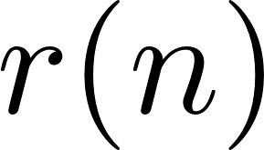

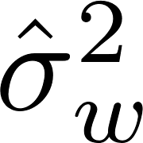



SM-0
SM-1
SM-M
Threads on CUDA Cores
Threads on CUDA Cores
Threads on CUDA Cores
Block 0
Block 1
Block 2
Block 3
Block 0
Block 1
Block 2
Block 3
Block 4
on GPU chip
Registers
Registers
Registers
PCI Express
Bus
Host Memory
L1
Shared Memory
L1
Shared Memory
L1
Shared Memory
L2
Global Memory
Preamble Detection
Offset Estimator
Channel
Estimator
Frequency
Noise
Estimator
Apply
Equalizer
Apply
Detection
Filter
Detector
Compute
Equalizer

Slide 3
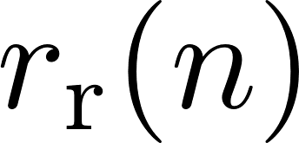
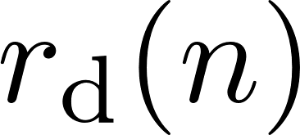
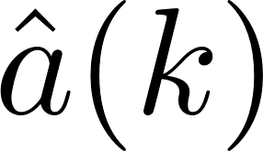
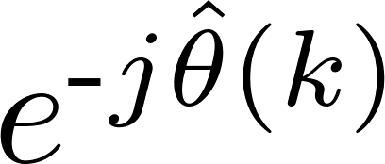
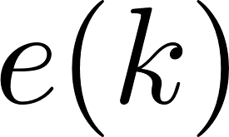

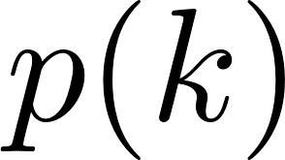
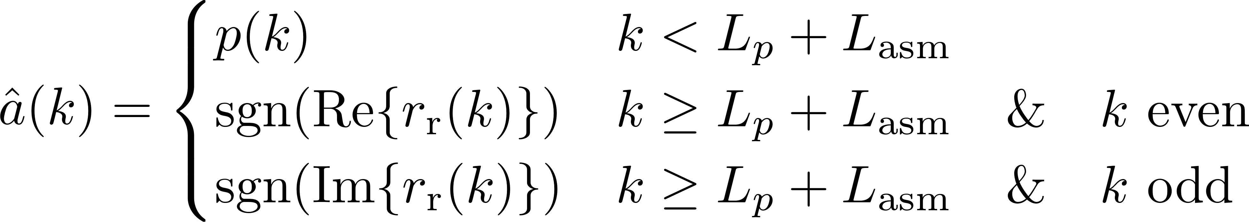
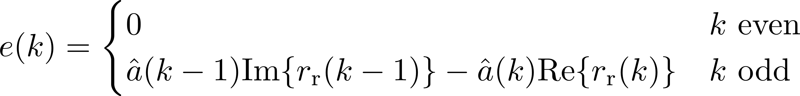
MUX
DDS
PED
MUX

Slide 4

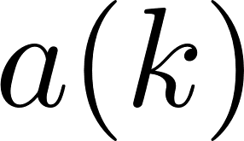

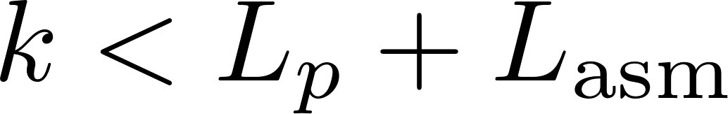
MUX
DDS
PED

Slide 5

preamble detector
search
algorithm
packetize samples

